Slide 1
MOD006671 Quantitative Methods for Banking and Finance
Week 2 Seminar – Basic Quantitative Analysis using SPSS

Slide 2
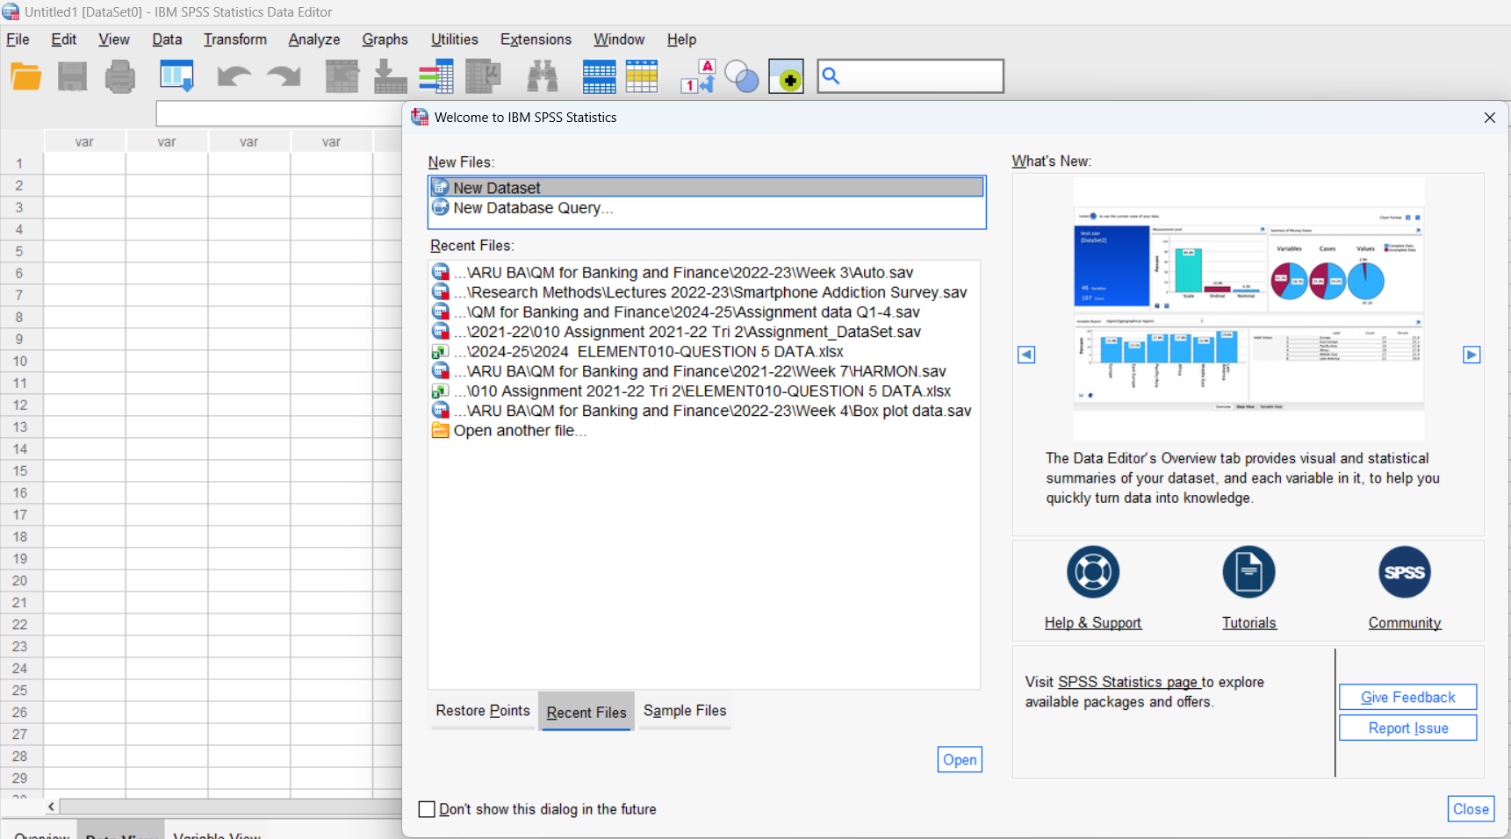
Producing basic descriptive statistics in SPSS
Open SPSS
Click New Data Set

Slide 3
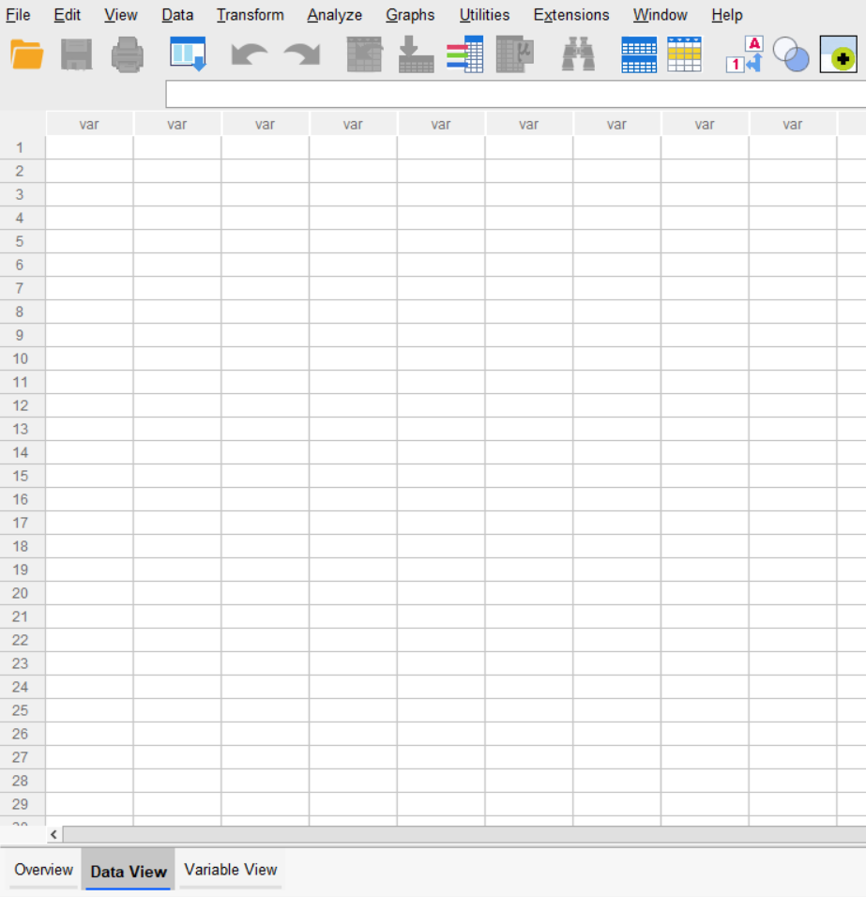
Get familiar with SPSS
There are 2 views of the Data:
Data View
Variable View

Slide 4
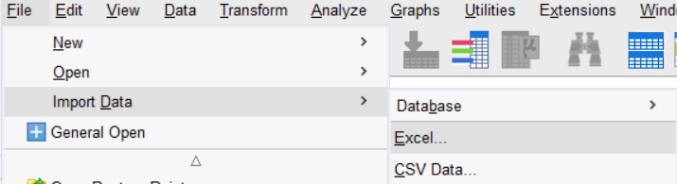
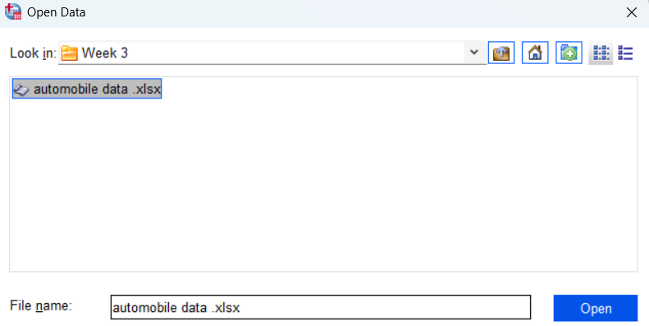
Import Data to SPSS from Excel
Go to File Menu, then click Import
Choose Excel
Choose
Automobile data.xlsx

Slide 5
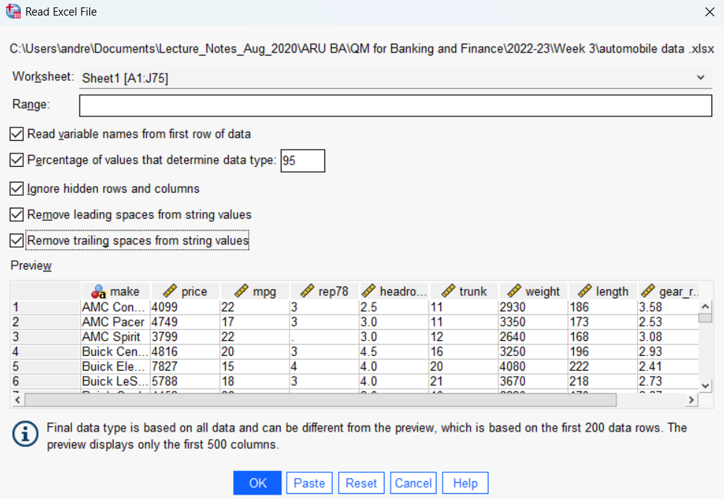
Check boxes based on the characteristics of the data being imported
Click OK

Slide 6
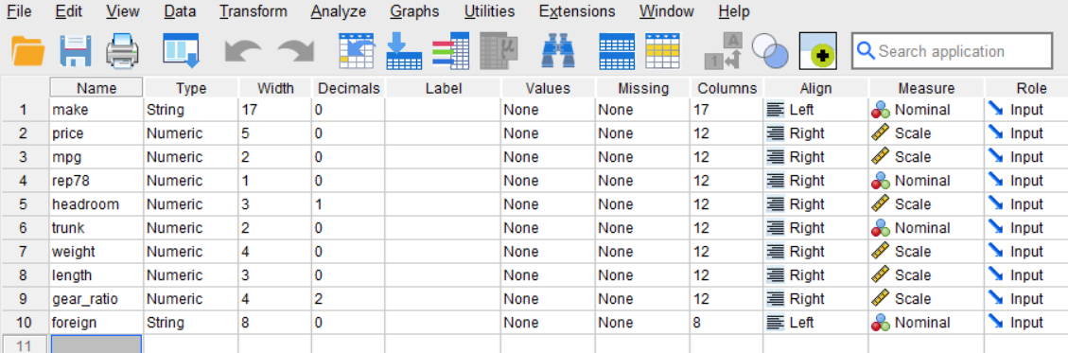
Code Variables- Setup your data
Go to Variable View
Based on your data you may need to:
1. change the TYPE
2. Label the variable
3. Code values
e.g. 0- Female, 1- Male
4. Change Measure to match type of data

Slide 7
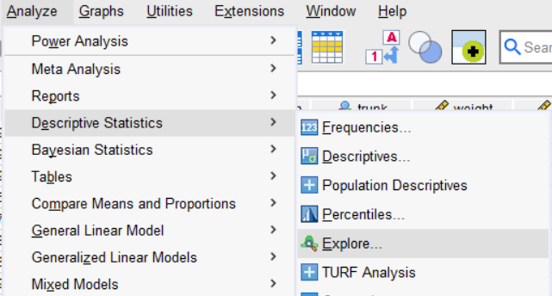
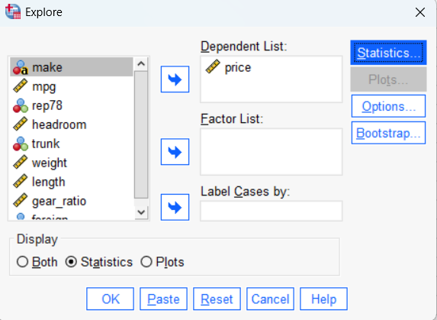
Ready to Start Descriptive Analysis
Go to Analyze Menu
Choose Descriptive Statistics
Click Explore
Choose Variable “Price” from list
Click arrow for Dependent List
Choose Statistics radio button
Click OK

Slide 8
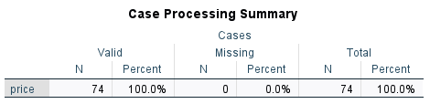
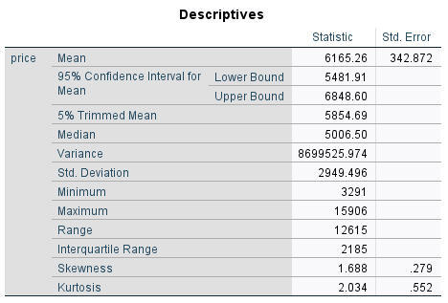
Interpret Results

Slide 9
Explore using other Variables
Mpg
Weight
Headroom

Slide 10
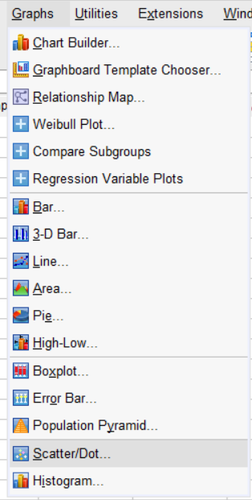
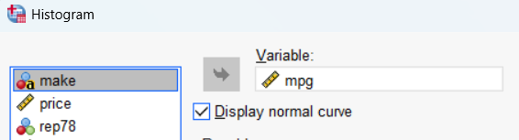
Histogram- assess distribution of data
Go to Graphs Menu
Choose Histogram
Select mpg, click arrow
Check Display normal curve
Click OK

Slide 11
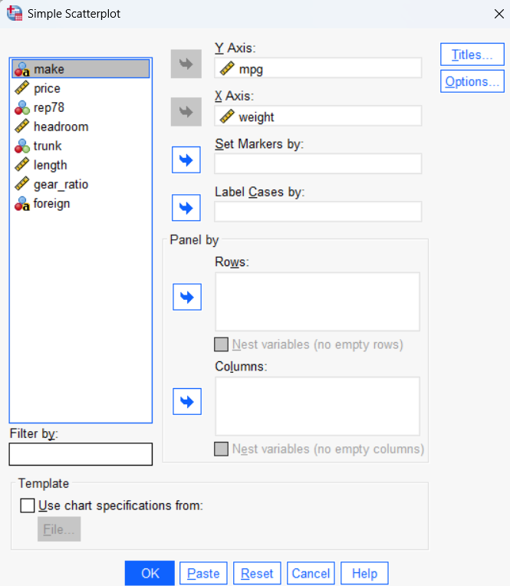
Scatter Plot- relationships between different variables
Suppose you are suspecting some form of causal relationship exists between mpg and weight of a car.
You can plot a scatter diagram

